Slide 1
Introduction to SQL
May 2019
Michael Sinclair
Data Scientist

Slide 2
Course Content
Introduction to SQL, Databases and RDBMS
Relational databases
Joins and keys
Select statements
Conditional Queries
Queries across multiple tables
Aggregate functions
Create TABLES and VIEWS
Additional resources

Slide 3
What is SQL?
Created by IBM in 1979 SEQUEL was renamed SQL
Structured Query Language allows you to access and manipulate databases
SQL is an American National Standards Institute (ANSI) standard

Slide 4
Edgar. F. Codd
Invented the relational database
Boyce-Codd Normal Form (BCNF) or 3.5 Normal Form
Developed in 1974 by Raymond F. Boyce and E. F. Codd

Slide 5
Database
Minimise Redundancy
Data redundancy is a condition created within a database or data storage technology in which the same piece of data is held in two separate places. This can mean two different fields within a single database, or two different spots in multiple software environments or platforms.
Non-relational
Relational
Shelf | Available | BookTitle | ISBN | Author
1001 | Yes | Mr Happy | 978-1405274845 | Roger Hargreaves
1001 | No | My Happy | 978-1405274845 | Roger Hargreaves
1001 | No | Mr Noisy | 978-1405274685 | Roger Hargreaves
1001 | Yes | My Noisy | 978-1405274685 | Roger Hargreaves
2001 | Yes | The Eyre Affair | 978-0340733561 | Jasper Fforde
2001 | No | The Eyre Affair | 978-0340733561 | Jasper Fforde
Library
Item_ID
Book_ID
Shelf
Available
Author
ID
Name
Book
ID
Title
Author_ID
ISBN

Slide 6




RDBMS
Relational Database Management Systems
Oracle
MS Access
MS SQL Server
MySQL

Slide 7
Relational Database
Relational databases are made up of several tables joined together in relationships

Slide 8

Relationships
Library
Item_ID
Book_ID
Shelf
Available
Book
ID
Title
Author_ID
ISBN
Author
ID
Name
1
1
∞
∞
A library can have more than one copy of each book
A book has one author
An author can write more than one book

Slide 9

Keys
Each table has a UNIQUE primary key which can identify each record
A primary key in a different table is called a foreign key
Book
ID
Title
Author_ID
Author
ID
Name
1
∞

Slide 10
Many to Many relationships
Store
ID
Name
ISBN_number
∞
Book
ISBN_number
Name
1
Stock
record_ID
Store_id
ISBN_number
Stock_level
∞
∞
1
∞

Slide 11
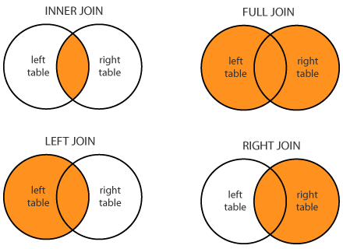
Joining Tables
Stock
ISBN13
Store_id
Stock_level
Book
ISBN
Title
Author_ID
Published
Wards
Ward_ID
WardName
Population
WardArea
HealthData
ID
WardID
SmokingRate
ExcessWeight

Slide 12
Data Types
Data type | Description
Text | Use for text or combinations of text and numbers. 255 characters maximum
Integer | Allows whole numbers between -32,768 and 32,767
Long | Allows whole numbers between -2,147,483,648 and 2,147,483,647
Single | Single precision floating-point. Will handle most decimals
Double | Double precision floating-point. Will handle most decimals
Currency | Use for currency. Holds up to 15 digits of whole dollars, plus 4 decimal places. Tip: You can choose which country's currency to use
AutoNumber | AutoNumber fields automatically give each record its own number, usually starting at 1
Date/Time | Use for dates and times
Yes/No | A logical field can be displayed as Yes/No, True/False, or On/Off. In code, use the constants True and False (equivalent to -1 and 0). Note: Null values are not allowed in Yes/No fields

Slide 13
SQL coding
Code appears like this within this presentation

Slide 14
Training Database
Stores
Branchid
Name
Address
Postcode
City
Stock
Id
Store_id
ISBN_number
Stock_level
Books
ISBN13
Title
Genre
Series
No_Pages
AuthorID
Published
Author
ID
Author
1
1
1
∞
∞
∞

Slide 15
Anatomy of a query
Select output contents, Aggregate Functions go here
SELECT Author, SUM(No_Pages)
Source
FROM books
JOIN(s)
JOIN author ON books.AuthorID = author.ID
Conditions
WHERE Pages > 100
GROUP / SORT / HAVING
GROUP BY Author

Slide 16
SELECT statement
TRY IT OUT
SELECT *
FROM book
The * can be read as ‘all’ so this query can be read as select all from book.
This query will select all fields from the book table.

Slide 17
Conditional statements
WHERE
= Equals
<> Does not equal
LIKE / NOT LIKE Is like (this is supported by wild cards)
The % character can be used as a wild card

Slide 18
Practical Examples
TRY IT OUT
Using the practice database
List all books by Ian Fleming
List all books longer than 700 pages

Slide 19
Like / Not Like examples
COUNTRIES
SELECT * FROM COUNTRIES WHERE
Armenia
Serbia
Russia
Haiti
Somalia
Belarus
Kazakhstan
Comoros
Name like ‘s%’
Name like ‘%s’
Name like ‘%s%’
Name not like ‘%s%’

Slide 20
Conditional statements continued
WHERE
BETWEEN
IN

Slide 21
Practical Examples
TRY IT OUT
Using the practice database
The date of Publication is “yyyy/mm/dd”
Using Date() function and BETWEEN select all books published in 2010
Notes:
SELECT Title, Published, DATE(Published), strftime('%Y',DATE(Published)) as year
FROM Books
WHERE year = '2010’

Slide 22
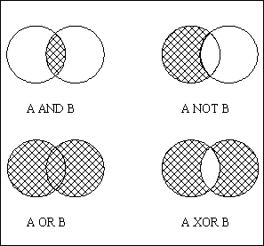
AND / OR / XOR
Nested
SELECT
WHERE
AND ( x OR y)

Slide 23
Practical Examples
TRY IT OUT
Using the practice database
Select all books with more than 200 pages AND containing the word “love” in their title
Select all books with more than 200 pages AND title contains either “go” OR “die”

Slide 24
Joining Queries
UNION
SELECT * FROM Table1
WHERE condition
UNION
SELECT * FROM Table2
WHERE condition
The difference between Union and Union all is that Union all will not eliminate duplicate rows, instead it just pulls all rows from alltables fitting your query specifics and combines them into a table. A UNION statement effectively does a SELECT DISTINCT on the results set

Slide 25
Aggregate function
AVG() - Returns the average value
COUNT() - Returns the number of rows COUNT(DISTINCT)
FIRST() - Returns the first value
LAST() - Returns the last value
MAX() - Returns the largest value
MIN() - Returns the smallest value
SUM() - Returns the sum

Slide 26
GROUP BY()
SELECT ward, COUNT(variable)
FROM Dataset
GROUP BY (ward)
If GROUP BY() is not used an error will be received stating
“variable is not part of an aggregate function”
Using: strftime('%Y',DATE(Published)) as year
What year had the most books published
TRY IT OUT

Slide 27
Practical Examples
TRY IT OUT
Using the practice database
How many series contain more than 8 books? List them
How many series are included in the dataset
Summary statistics, By Author show the minimum, average, maximum and total pages that they have written in their books
Based on these results, what kind of books does Adam Hargreaves write

Slide 28
ORDER BY()
SELECT ward, COUNT(variable)
FROM Dataset
GROUP BY (ward)
ORDER BY (ward)
This will order the wards from Abbey to Whalebone
If you would like to order from Whalebone to Abbey use
ORDER BY (ward) DESC

Slide 29
HAVING
SELECT column_name, aggregate_function(column_name) FROM table_name WHERE column_name operator value GROUP BY column_name HAVING aggregate_function(column_name) operator value

Slide 30
Practical Examples
TRY IT OUT
Using the practice database
How many pages has each author written
Use HAVING to show only those authors who have written more than 1000 pages
Which author has written the most pages in the dataset

Slide 31
Anatomy of a query (with HAVING)
Select output contents
SELECT Author, SUM(No_Pages)
Source
FROM books
JOIN(s)
JOIN author ON books.AuthorID = author.ID
Conditions
WHERE Pages > 100
GROUP / SORT / HAVING
GROUP BY Author
HAVING SUM(No_Pages) > 1000

Slide 32
Advanced queries

Slide 33
AS
Using the AS statement you can name
Fields
SELECT Book_ID AS Book
Tables
SELECT Book_Name, Author_Name
FROM Book_table AS Book
JOIN Author_table AS Author ON Book.ID = Author.ID

Slide 34
Nested SELECT Statements
Nested SELECT statements allow you to use the results of a SELECT statement in another statement
Use in a IN statement
SELECT ProductName FROM Product WHERE Id IN (SELECT ProductId
FROM OrderItem WHERE Quantity > 100)
Query the results of a query

Slide 35
Case / IFF
Case
WHEN condition THEN
ELSE
Example
SELECT CASE
WHEN date >= ‘2015-04-01' THEN '2015/16'
WHEN date >= ' 2014-04-01' THEN '2014/15'
WHEN date >= ' 2013-04-01' THEN '2013/14'
ELSE 'Before Sep 13'
END AS school_year
IFF
IFF(condition, valueifTRUE, valueifFALSE)
Example
SELECT Study_LSOACode, Sum(smoker) as smokers, Sum(exsmoker) as Exsmokers, Sum(nonsmoker) as Nonsmokers
FROM(
SELECT Study_LSOACode,
IIF(QOF_SmokingStatus = '1', '1', '0') AS smoker,
IIF(QOF_SmokingStatus = '2', '1', '0') AS exsmoker,
IIF(QOF_SmokingStatus = '3', '1', '0') AS nonsmoker
FROM Healthanalyticsdata
)
GROUP BY Study_LSOACode;

Slide 36
Additional items

Slide 37
Quiz
Which command do you use to extract data from a database?
How would you select all records from a table called ‘Books’
List and explain the types of JOIN clauses?
What is the difference between WHERE and HAVING?

Slide 38
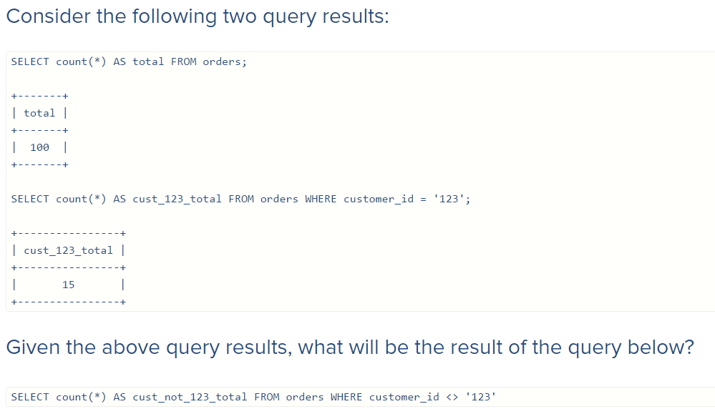
Quiz continued

Slide 39
Additional Resources
http://www.w3schools.com/
https://www.codecademy.com/learn/learn-sql
https://www.sololearn.com/Course/SQL/

